Slide 1
Simulation of the species-area relationship with a lattice Bak-Sneppen model
Ruud Sperna Weiland
Mark Voschezang
Wouter Meering
Freek van den Honert
Thomas Start
Notes:
thomas

Slide 2
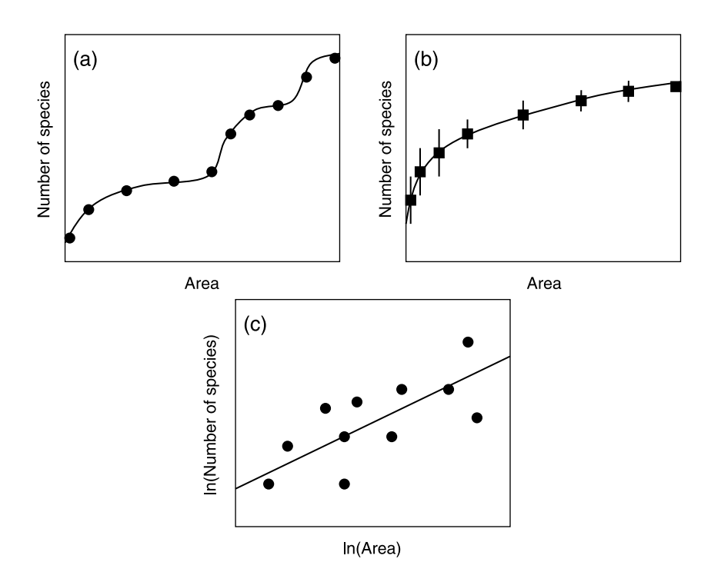
Species-area relationship
Often observed ecological pattern
Species-area curve shows power law behavior with slope ~0.25
Rate of increase in species richness decreases as sample area increases
Six types of species area curve - S. Scheiner
Notes:
thomas Six types of species area curve - S. Scheiner
It has never been found how this species-area relationship comes to existence, we will try to explain it using an evolutionairy model

Slide 3


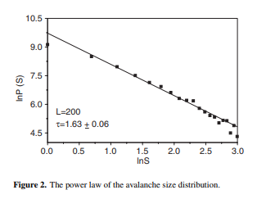

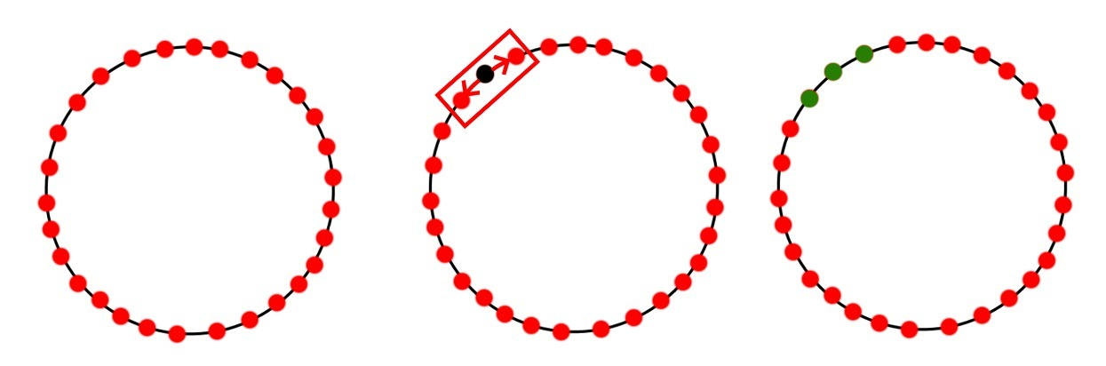
Bak-Sneppen Model
Simple model of co-evolution in an ecological network
Darwin: species with lowest fitness goes extinct
Neighbors dependent on extinct species also mutate
Single mutation can cause extinction cascade in the network, causing extinction avalanches
Size of extinction avalanches follows power law, resembles real extinction events
Lee, C., Zhu, X., & Gao, K. (2002). Avalanche dynamics in the Bak–Sneppen evolution model observed with a standard distribution width of fitness. Nonlinearity, 16(1), 25.
1 2 3
Notes:
thomas
co-evolution model
each species fitness value
ring network with species
each iteration
species with lowest fitness goes extinct this species and its neighbors go extinct
cascade of extinctions can arise this is called an avalanche
Size of an avalanche behaves in a power low distributed behavior

Slide 4
How are these phenomena connected?
Both phenomena suggest ‘life’ is in a self-organized, critical state.
Can the species-area relationship be explained by co-evolution, using the Bak-Sneppen model as a basis?
Notes:
thomas
Which effect do evolution mechanisms have on the spread of organisms

Slide 5
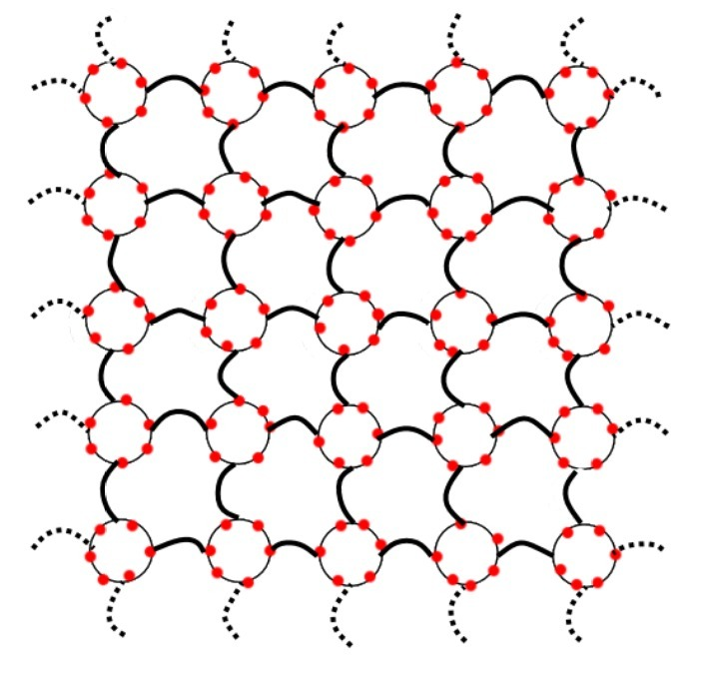
Spatial Bak-Sneppen
Addition of spatial component
Migration mechanism needed in addition to mutation
Each lattice-point contains a BS-model
Initially every lattice site consists of N unique species in a BS-model
Notes:
thomas Square lattice, NxN, Periodic boundaries
To explain the area for the species area curve, a lattice of BS models.
these can be accounted as areas filled with species

Slide 6
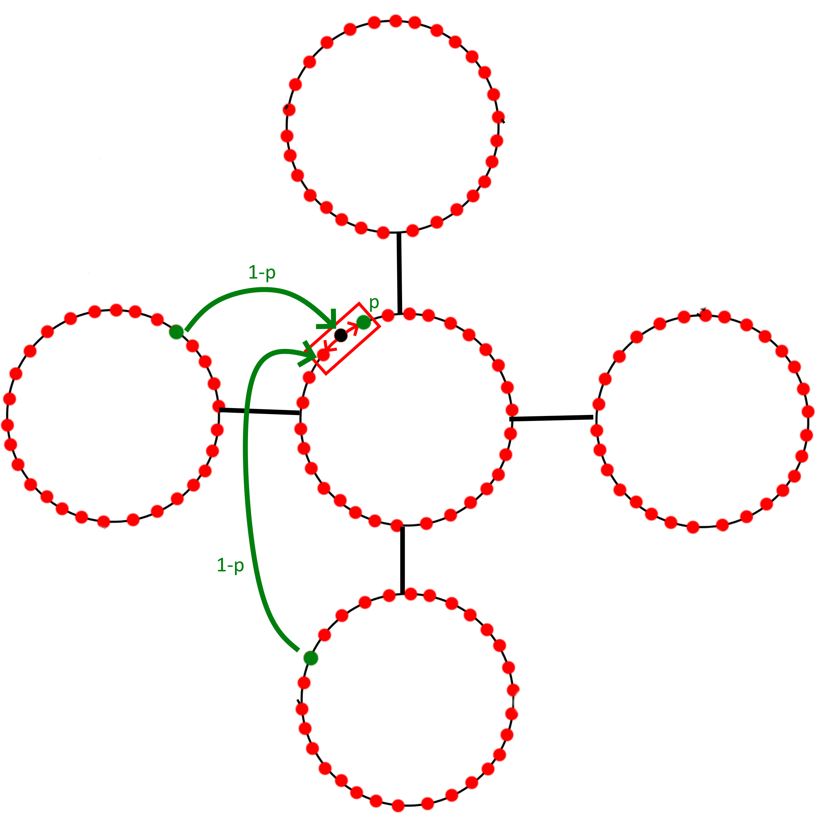
Spatial Bak-Sneppen
Least fit species goes extinct → neighbors also go extinct
p = probability of mutation
1-p = probability of migration
Assume migration happens more frequently than mutation, p small
Migration from a random neighbor, with a certain priority depending on fitness.
Fitness correlation, effect of prior species fitness on fitness of migrating/new species
Notes:
thomas
each lattice site is updated
lowest fitness migrates with a chance 1-p or mutates with chance p

Slide 7
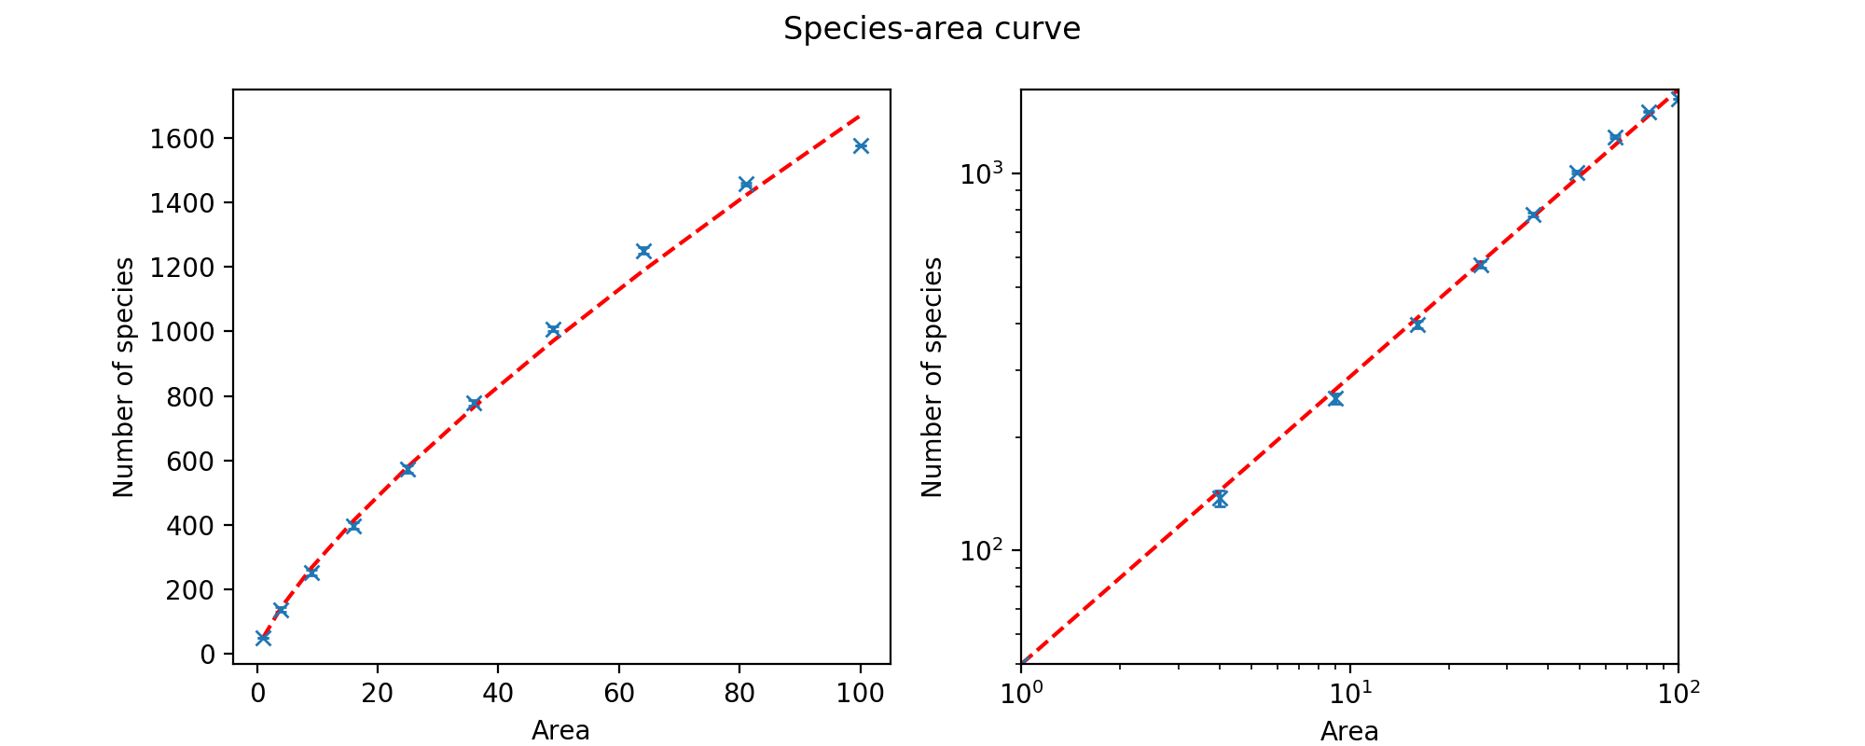
Sample run on 10x10 lattice
Notes:
Ruud

Slide 8
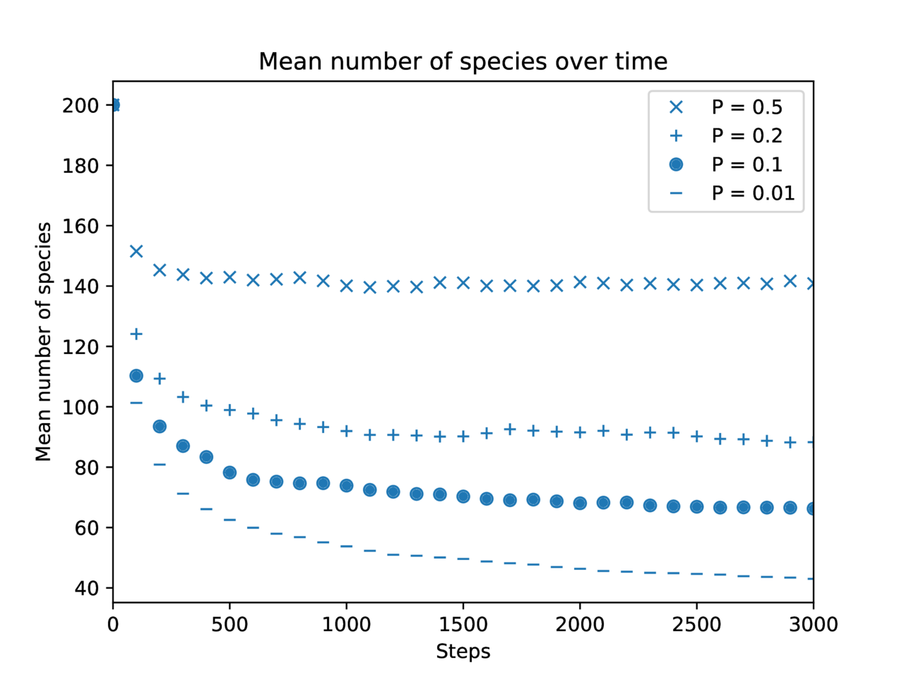
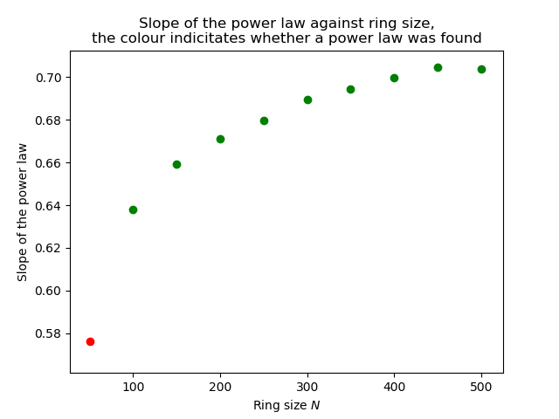
Parameter p and N
Notes:
Ruud

Slide 9
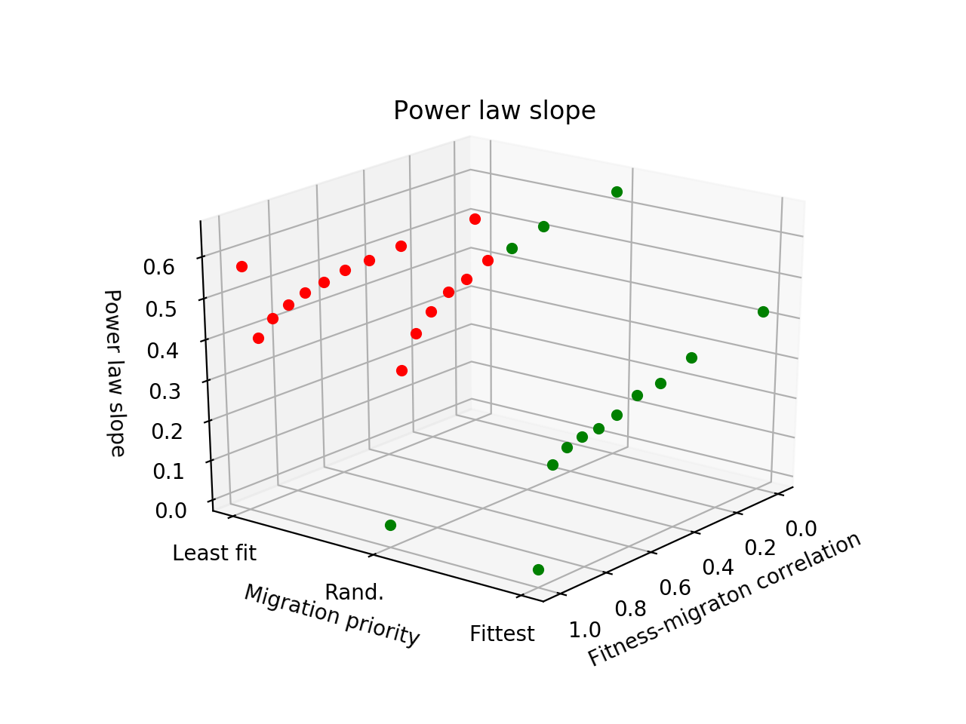
Parameters
p = 0.001, almost only migration
No power law relation for lowest fitness priority
Perfect power law relation for highest fitness migration priority
Slope of 0.302 for
fitness-migration correlation: 0.88
migration priority: fittest
Notes:
Ruud “Fitness-migration correlation” controls power law slope. Red dots indicate a poor power law fit
10x10, N=100, t=3000

Slide 10
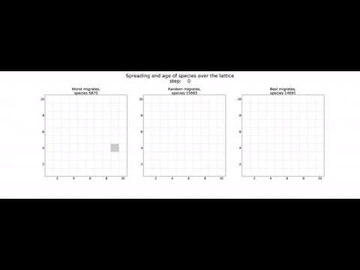
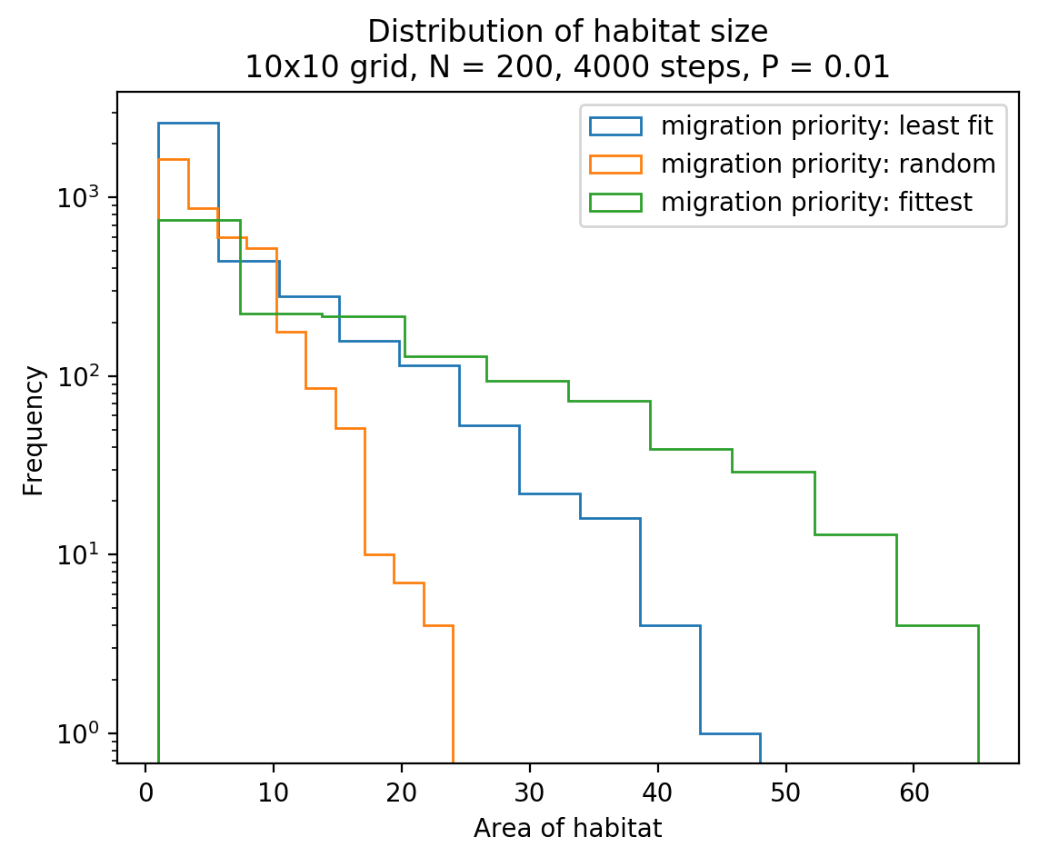
Migration of species over lattice
Notes:
Ruud

Slide 11
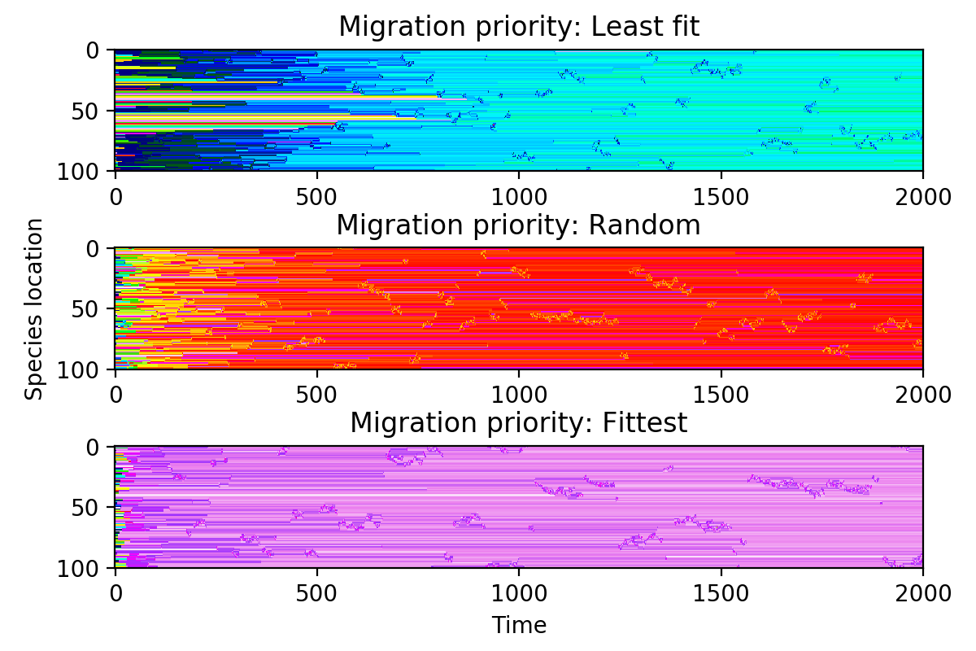
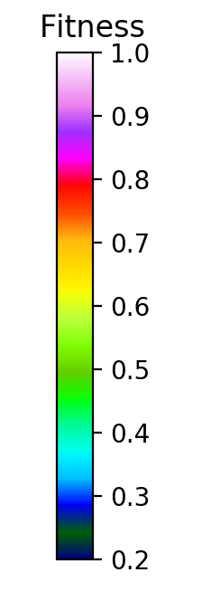
Avalanches
Notes:
Start at t=300 (after convergence)
Note the differences in critical fitness

Slide 12
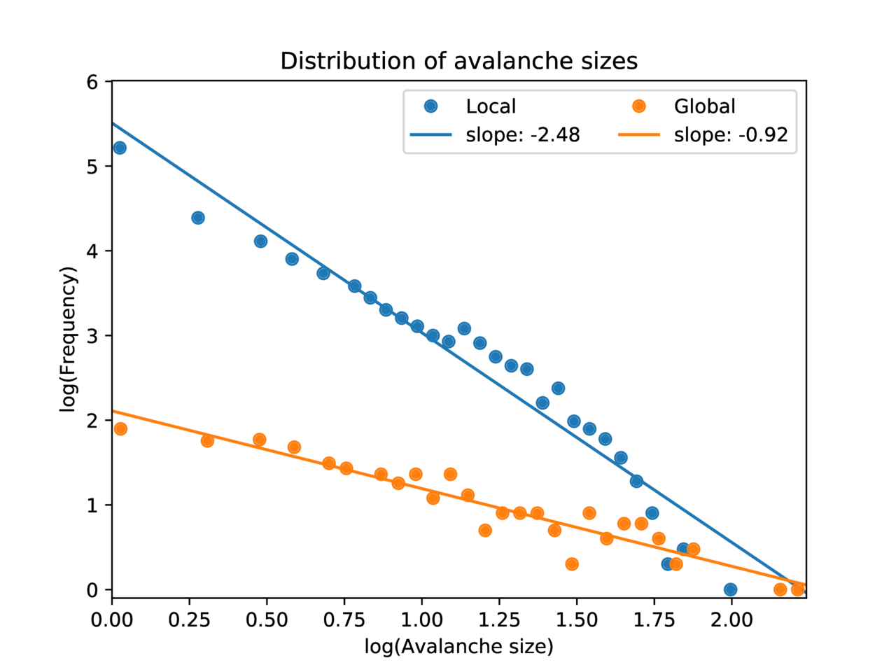
Avalanche size
distribution
Notes:
Global avalanche: check lowest global fitness. if fitness decreases in an iteration, the avalanche continues, else a new one is started
Ensemble: 5x model with t=4000

Slide 13
Conclusion
Species-area relationship reproducible using simple local dynamics
Understanding on what migration type happens in nature
Role of migration much larger than of mutation
But model still uses Darwinian principle
Next: different migration mechanisms, networks

Slide 14
Questions?

Slide 15
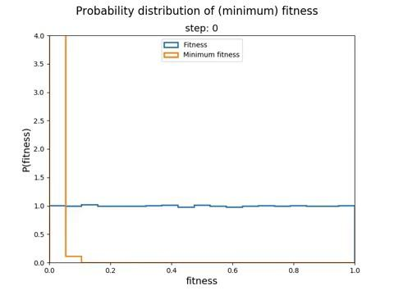
Fitness distribution

